Slide 1
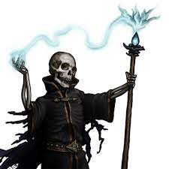
The Night of the Liche
Pitch Date: 12/18/2022 Update 1/15/2023
Release Date: 4/9/2023 103 Commits
Team Lead: Vince McKeown 9 Contributors

Slide 2
Vince McKeown
Coding
Enemies can track and advance to player.
NPC’s are now in lists
Player
Sword swing to the South
Skeleton
Animated Skeleton Walk North West/East
Ground Objects
Flowers, Mushrooms, and logs

Slide 3
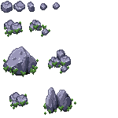
Tylor Allison
Rocks

Slide 4

Christer “McFunkyPants” Kaitila
Added darkness

